Slide 1
Innovation Management and Entrepreneurship
Prof. Koliya pulasinghe

Slide 2
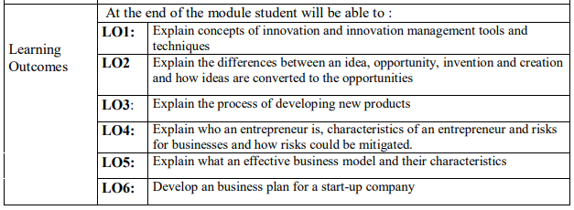
Innovation Management and Entrepreneurship

Slide 3


Recommended Textbooks for the Course

Slide 4
Evaluation Criteria
Continuous Assessments - 30%
Group works – Preparing a Business Plan for an innovative product or service and make a pitch - 20%
Class Presentations - Reading a selected research paper or a chapter from a textbook Chapter 10%
Final Exam – 70%
Two- hour paper having 4 questions
each question is given equal marks

Slide 5
CA – Business Plan & Pitch
Students are divided into several groups, having maximum 4 students for each group
Group members will decide an innovative business idea for a product or service.
Product or service can be an IT solution, an innovative service, or any product that
Write a business plan for that innovative idea and Pitch
Guidelines will be provided

Slide 6
CA – Class Presentation
Student Groups are provided a paper or a chapter of a text book
Group members must read the chapter and make a presentation to the class.
No Mid Semester Exam

Slide 7
Learning Outcomes
Explain Product, Service and Process Innovation
Explain Incremental and Radical innovation
Explain Architectural and Modular innovation
Describe Innovation Management

Slide 8
Invention
Creating something new that has never existed before.
The inventive step and non-obviousness reflect a general patentability requirement present in most patent laws, according to which an invention should be sufficiently inventive—i.e., non-obvious—in order to be patented.
Non-obviousness principle asks whether the invention is an adequate distance beyond or above the state of the art". - Wikipedia

Slide 9



Innovation
“Innovation means doing something new that improves a product, process or service” - WIPO

Slide 10
Innovation
Innovation is the process of making changes to something established by introducing something new that adds value to customers and contributes to the knowledge store of the organization.
Innovation management allows the organization to respond to external or internal opportunities, and use its creativity to introduce new ideas, processes or products.
Kelly, P.; Kranzburg M. (1978). Technological Innovation: A Critical Review of Current Knowledge. San Francisco: San Francisco Press.

Slide 11
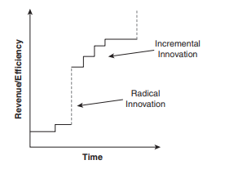
Incremental and Radical Innovation
Radical innovation is about making major changes in something established
Incremental innovations consist of smaller endeavors, making them easier to manage than RI.

Slide 12

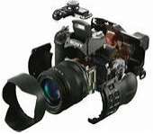
Architectural and Modular Innovation

Slide 13
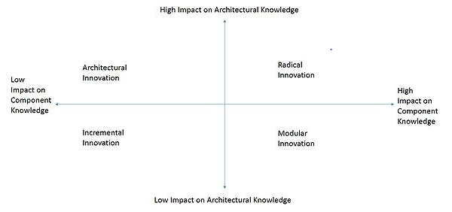
Architectural and Modular Innovation

Slide 14
Seven Sources of Innovation – Peter Drucker
The unexpected—the unexpected success, the unexpected failure, the unexpected outside event;
The incongruity – When the need is incongruent with supply
Innovation based on process need (necessity is the mother of innovation)
Changes in industry structure or market structure that catch everyone unawares.

Slide 15
Seven Sources of Innovation – Peter Drucker
Demographics: Different life style needs
Changes in perception, mood, and meaning
New knowledge: AI, Nano technology: both scientific and nonscientific.

Slide 16
Summary
Invention and Inventive step
Innovation
Innovation Management
Innovation: Product, Service, and Process
Innovation: Incremental & Radical
Innovation: Modular and Architectural
Seven Sources of Innovation

Slide 17
End of Lecture 1

